Slide 1
Political accountability under citizen scrutiny Practical case in crowdsourcing
HILLE HINSBERG
Praxis Centre for Policy Studies
ESTONIA
www.praxis.ee
Berlin, 2015

Slide 2
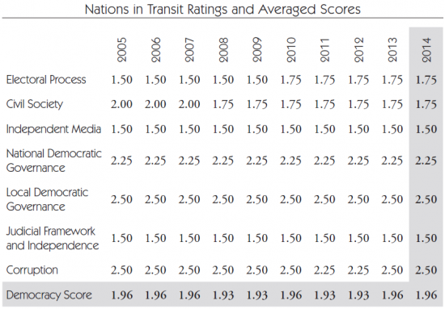
Estonia in Freedom House index: Democracy

Slide 3
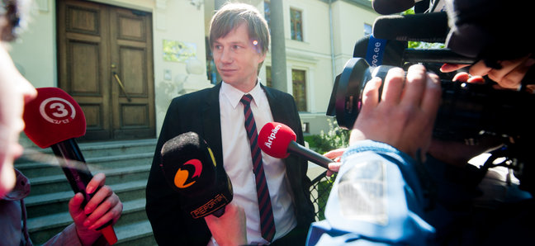
People´s Assembly process in 2012 – 2013: the trigger
The problem: ruling Reform party accepts anonymous donations
The whistleblower
Silver Meikar,
former MP,
Reform party

Slide 4
Public protests in 2012
Street demonstrations and keen media coverage
Petition collects 17,000 signatures
Public resentment and mistrust towards all politicians; disengagement from party politics
Investigation by the Prosecutor´s Office on several cases of illegitimate donations
Donations to Reform party decline

Slide 5
President calls for civic participation
Five main issues outlined at stakeholder meeting, called upon by the President:
Barriers to political movements
Financing and financial reporting of political parties
Public participation in policy making
Electoral system regulation
Political patronage and corruption

Slide 6
Teamwork by Civil Society activists: building the process for crowdsourcing
Phase 1: 6,000 proposals and comments on web
Phase 2: collating and analysis of web content
Phase 3: impact assessment and expert opinion on proposed amendments
Phase 4: stakeholder deliberation on main 5 issues
Phase 5: grass-root participation, Deliberation Day 314 participants or 62% of recruited sample select proposals to be sent to the Parliament

Slide 7
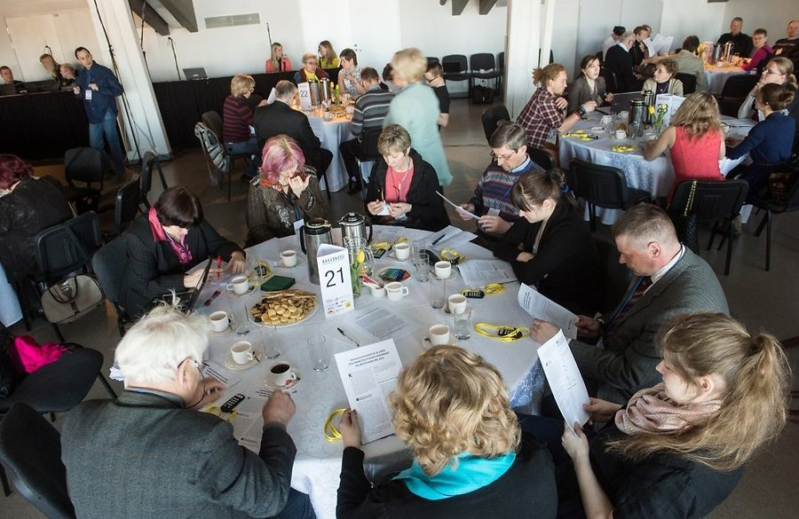
Deliberation Day

Slide 8
Role of the Parliament
President hands over all proposals created in deliberation process
Parliament Constitutional Committee deliberates
Parliament fractions form their opinion on proposals
Committee starts drafting legislative changes
Committee fails in its communication about the process

Slide 9
Results achieved 1 year after
Out of final 15 proposals, 3 have made their way into legislation + 4 have been partially adopted
Civic participation found its place in political agenda
The amount of financing from the state budget to the political parties that did not meet the election threshold was increased
A monetary fine will be imposed for accepting prohibited donations.
The power of the Political Party Funding Supervision Committee to check the finances of parties was increased
Legal act adopted for popular initiatives and presenting collective petitions to Parliament

Slide 10
Evaluation of the participation process
Share of participants who were satisfied with the process. Comparison of 2 Swedish cities and People´s Assembly
(Surveys by University of Örebro and Praxis)
Notes:
Critical participants
Most negative evaluation of the impact on policy
Most positive evaluation of the ease of use
Estonian participants are marketly more positive in their evaluations
Older participants than the other cases
Strong under representation of women
Strong over representation of highly educated
Domination of dissatisfied citizens
Strong under representation of previously dissengaged
Participant profile: Active and dissatisfied

Slide 11
Attitudes towards citizen participation
Scale:
1-5 Citizens should have less or the same level of influence on political decisions
6-10. Citizens should have more influence on political decisions

Slide 12
Change in trust vs social capital
Decreasing trust for institutions
Increasing trust for citizens and civil society
Notes:
Legitimimacy is affected by
Context matters - The ”level of crisis” may be a strong mediating factor
Only predisposition seems to influence trust
Citizens who are dissatisfied with Estonian democracy decreases their level of trust no matter what

Slide 13
Effects on political landscape
The first law was adopted, originating from collective petitioning
For national elections (1.03), several political platforms include Assembly proposals that were not yet adopted
2 new parties gained from Assembly proposals
lower mandatory deposit for setting up candidates, parties saved 50,000 EUR
only 500 members are required to form a Party, instead of previous 1000 persons
Notes:
. Parliament adopted a law increasing tax environment stability
Today/February 19th, the Parliament adopted an amendment to the Tax Administration Act. The proposal in was presented Estonian Chamber of Commerce and Industry, together with 1300 business people who signed the collective petition.

